Slide 1
Calculating
Support, Confidence and Lift to Derive Rules

Slide 2
Instructions
Refer to the table below that lists seven breakfast items sold in 12 transactions. Use the data given in the dataset to complete the activities listed on the next slide.
Transactions | Bread | Milk | Dosa | Pulses | Coffee | Omelette | Juice
1 | 1 |  | 1
2 | 1 | 1 |  | 1 |  | 1
3 |  |  |  |  |  | 1 | 1
4 |  |  | 1
5 | 1 | 1
6 | 1 |  | 1 |  | 1
7
8 | 1 | 1 | 1
9 | 1 | 1
10 |  |  |  |  | 1 | 1 | 1
11 | 1 |  | 1
12 |  | 1 |  |  |  |  | 1

Slide 3
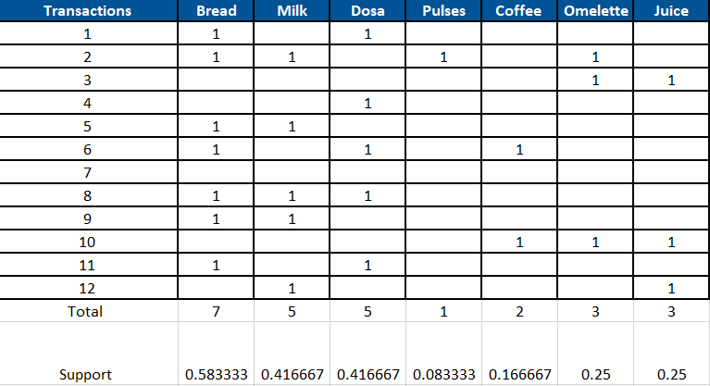
Calculate the support value for each product from the given dataset

Slide 4
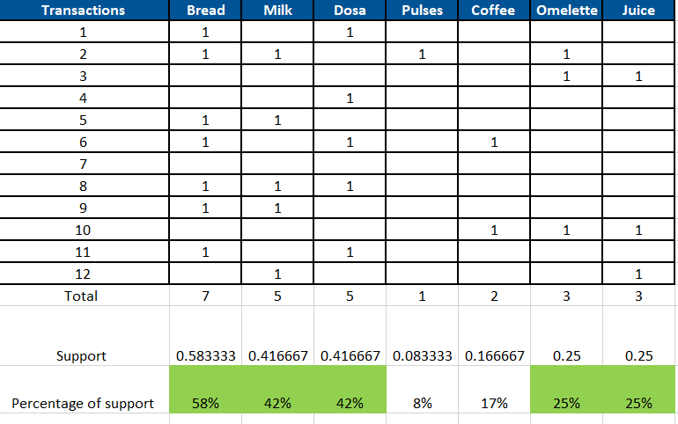
If minimum support is fixed at 22%, then which of the items are significant from the data. That is find out items having support greater than or equal to 22%
Bread, Milk, Dosa, Omelette, Juice are the items having support greater or equal to 22%.

Slide 5
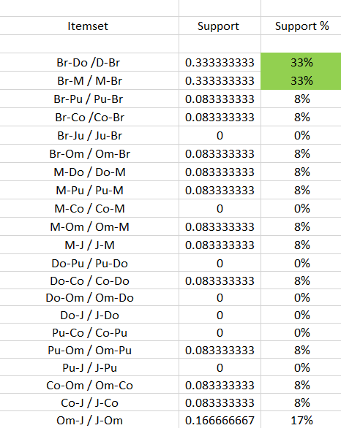
Create a table consisting of all 2-itemsets or pairs of items, having minimum support of 22%
Bread and Dosa
Bread and Milk
Is the combination that has support of equal or above 22%

Slide 6
Calculate support value for each of the 2-itemsets created from the above step

Slide 7
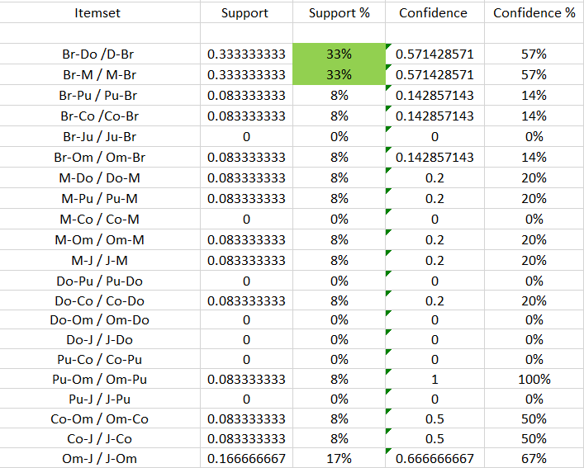
Calculate confidence value for each of the 2-itemsets created from the above step

Slide 8
If the confidence is fixed at 65% or more, then find out all frequent 2-itemsets from the 2-itemsets identified in the previous activities
2-Itemsets | Confidence
Pulses and Omelette | 100%
Omelette and Juice | 67%

Slide 9
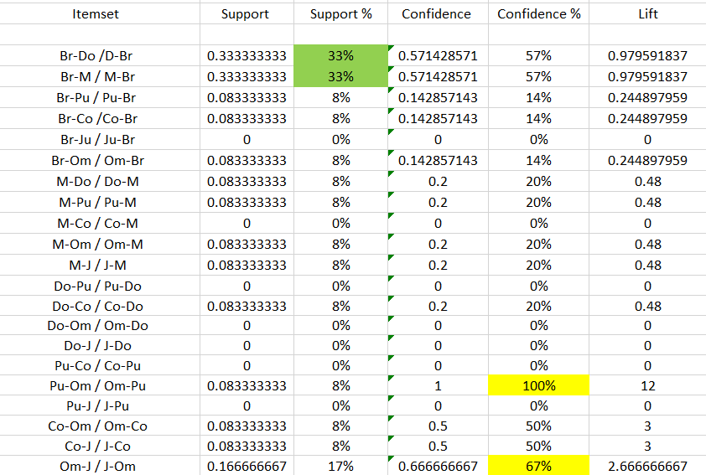
Calculate the lift of the association rules and list the two rules to be dropped
Valid rules and lift of these rules:

Slide 10
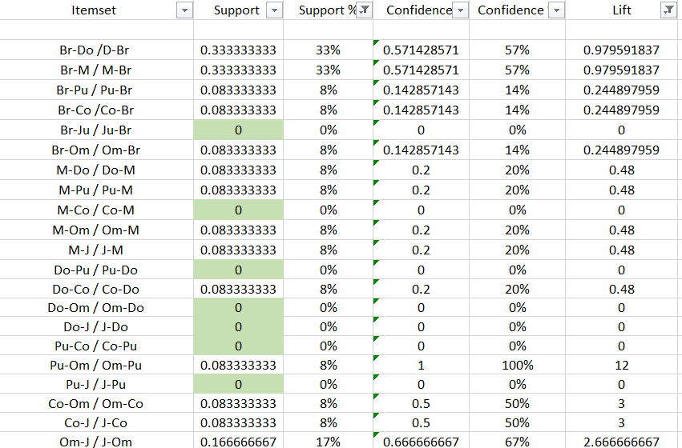
Calculate the lift of the association rules and list the two rules to be dropped
The two rules which cannot be part of the final rules as they do not satisfy the support value of 22% are as following:
Support and Support value cannot be part of the final rules
We can also eliminate the ones with 0

Slide 11
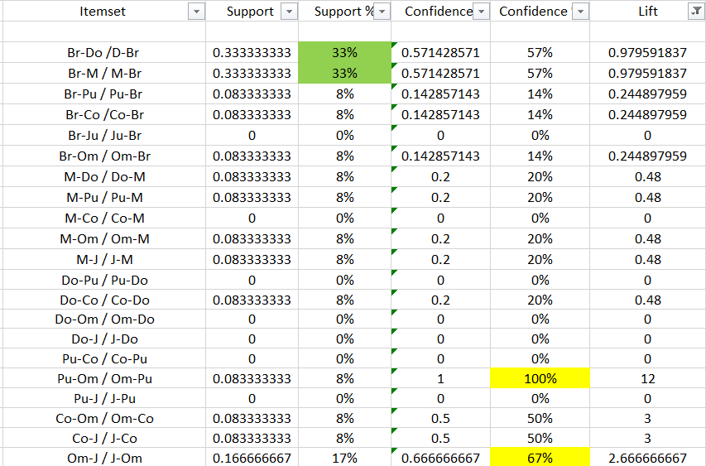
Calculate the lift of the two rules dropped in Activity 7

Slide 12
Compare support and confidence of the derived four rules from activity 7 and justify the selection of the two rules which can be considered as the final rules
Pulses and Omelette
Omelette and Juice
Once compared have we can consider confidence and lift as the two rules and take these as final rules
It satisfy the rule of confidence =<65%

